Slide 1
CIS 5525: Neural Computation
Week I: Introduction
Instructor: Kai Zhang
CIS @ Temple University, Spring 2021

Slide 2
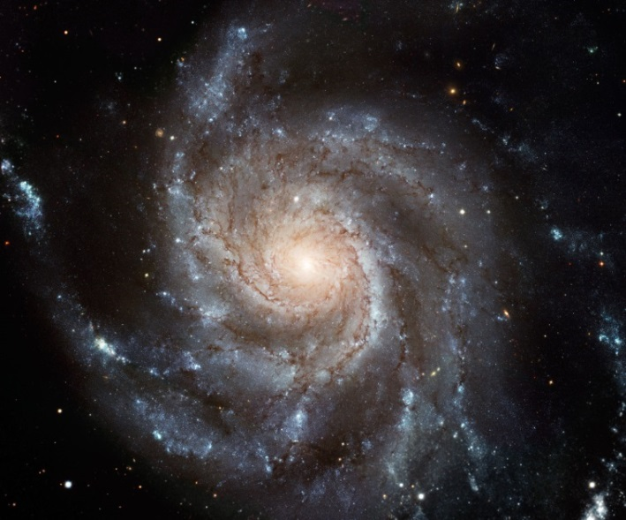
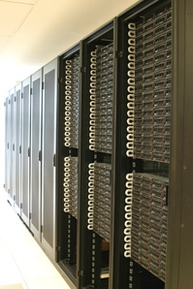
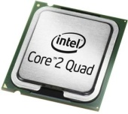

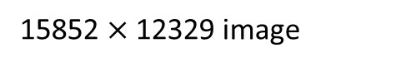
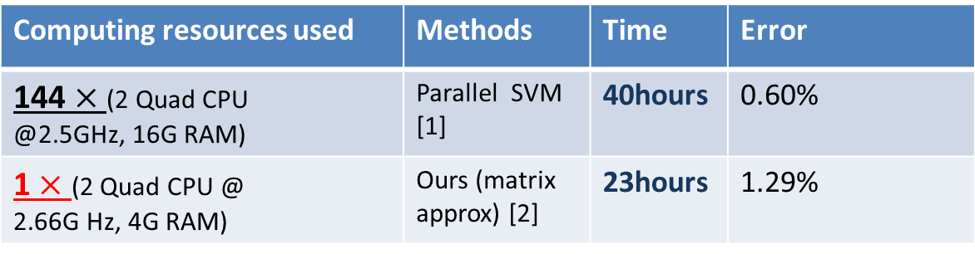
Research Highlights
Matrix / tensor decompositions
Manifold learning
Graph embedding
Supervised learning
Large-scale SVM
15852 $×$ 12329 image
Large-scale SVM in digit classification (8 million samples)
[ICML 2008, TNN 2010]
[AI&STAT 2012]
Computing resources used | Methods | Time | Error
144 $×$ (2 Quad CPU @2.5GHz, 16G RAM) | Parallel SVM [1] | 40hours | 0.60%
1 $×$ (2 Quad CPU @ 2.66G Hz, 4G RAM) | Ours (matrix approx) [2] | 23hours | 1.29%
20% memory
Semi-supervised
clustering
Randomized
algorithms
Transfer learning
Wifi-localization
[ICML 2009 & TNNLS 2015]
[ICML 2013]
[1] Z. Zhu et al., P-packSVM: Parallel Primal gradient descent Kernel SVM, ICDM 2009.
[2] Training Nonlinear support vector machines using limited resources: A Low-rank Linearization approach, AI&STAT 2012.
Multiple kernel
learning
Nonlinear tensor
CTR prediction
First $O\left(m+n\right)$ algorithm for fast SVD
[ICML 2012, AI 2016]
[NIPS 2016]

Slide 3

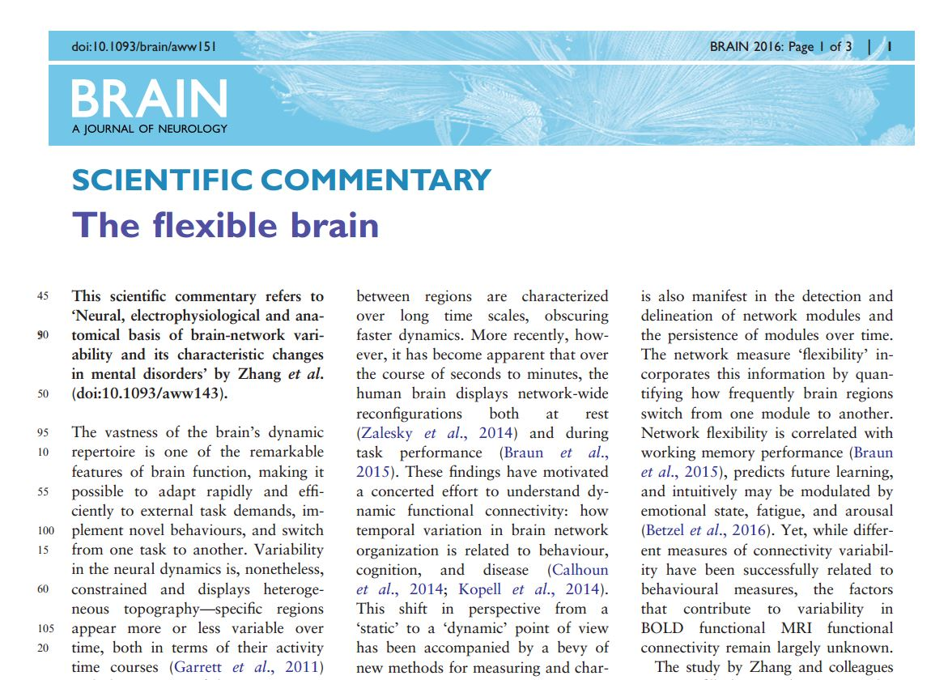

Research Highlights
Brain networks: Neural, electrophysiological and anatomical basis of brain-network variability and its characteristic changes in mental disorders. Brain (Aug) 2016, Co-first Author
Editor’s choice & cover paper
“… this study represents an important stepping-stone towards our understanding
of dynamics in functional
networks.”
2014 MacArthur Fellow Danielle Bassett

Slide 4
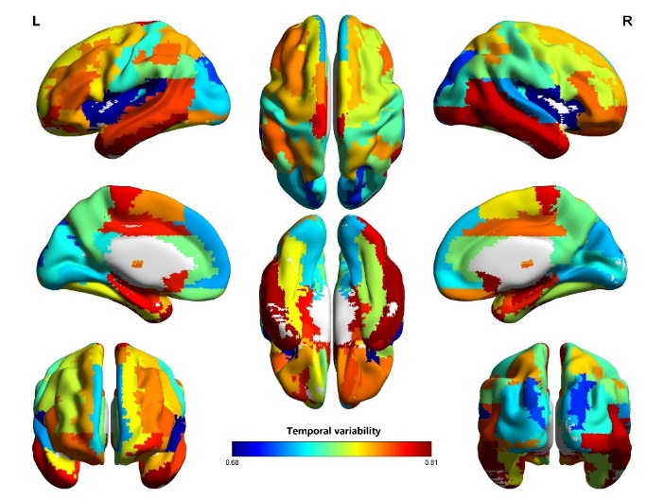
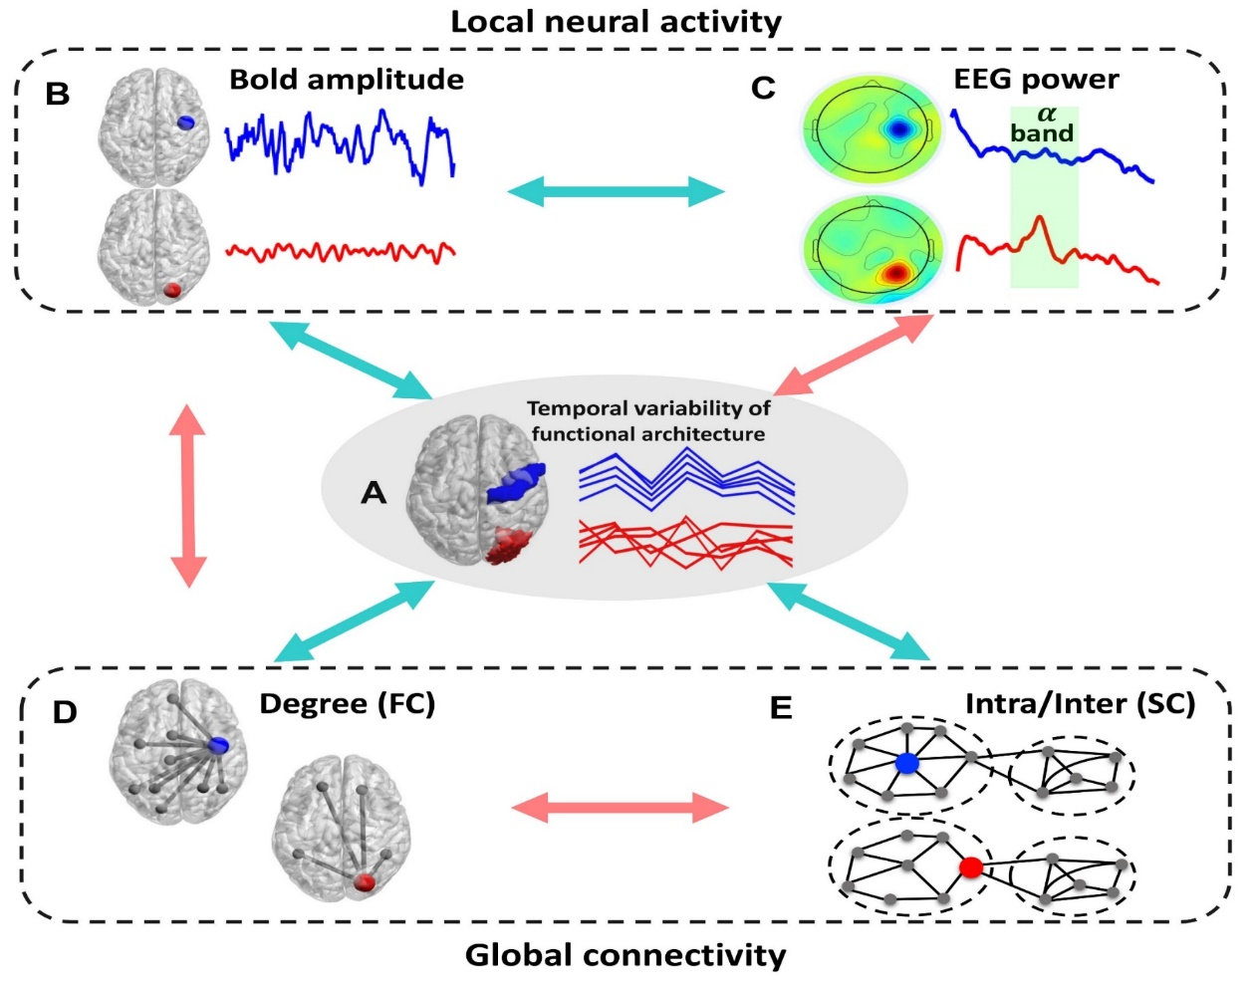
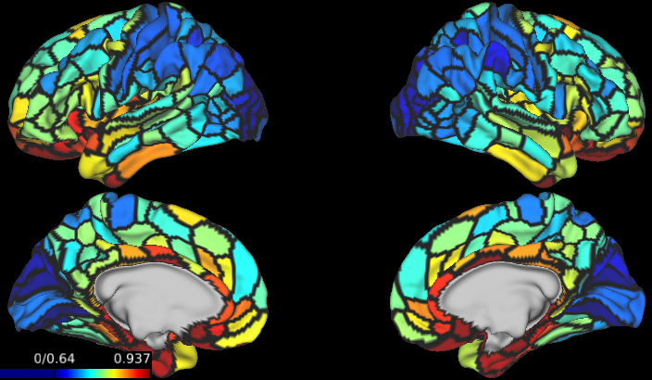
Research Highlights
Brain networks

Slide 5
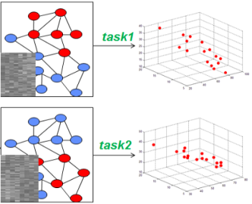
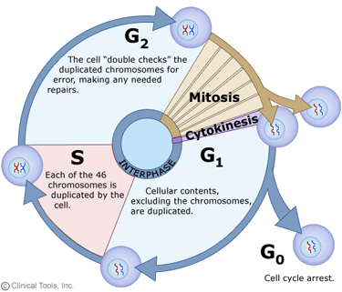
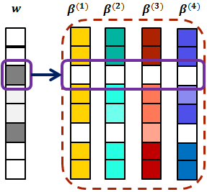
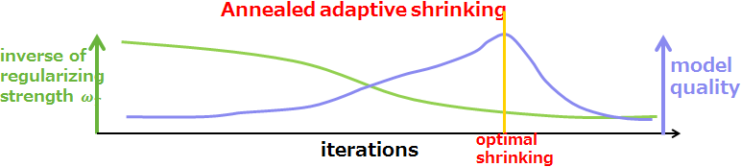
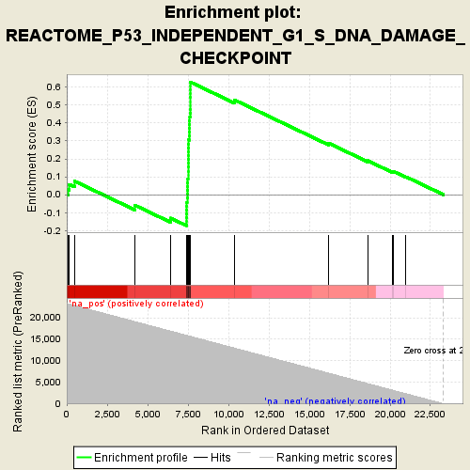

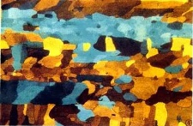
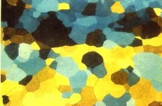
Research Highlights
Sparse Learning in Bioinformatics
Sparse multitask learning & cell cycle analysis [ISMB Bioinformatics 2010]
Annealed adaptive shrinking & eQTL analysis [KDD 2016]

Slide 6
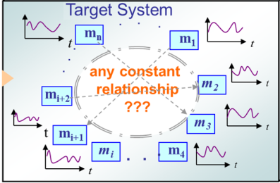
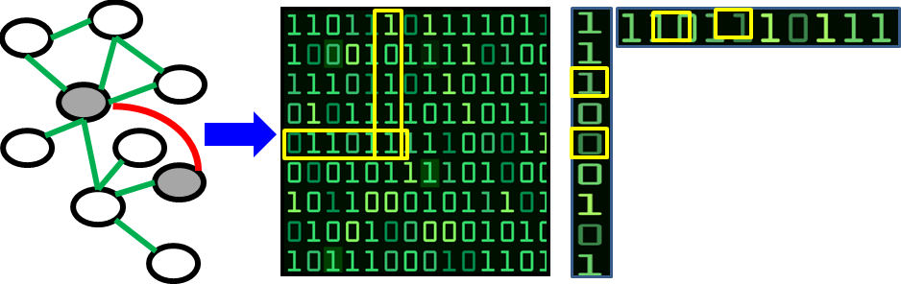
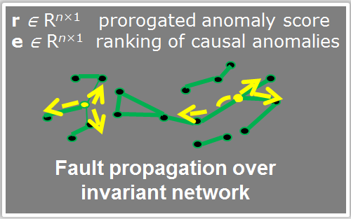
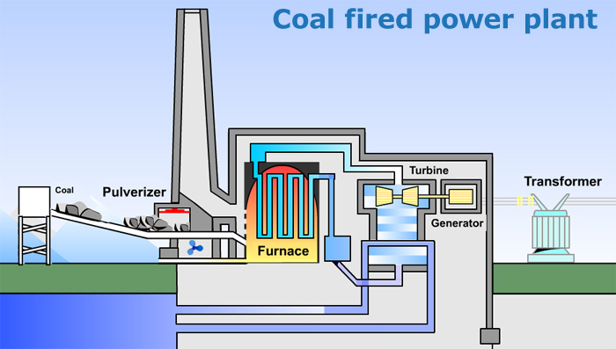
Research Highlights
Time Series Modelling
Anomaly detection and ranking [KDD 2016 Best Paper Runner-up Award]
Industrial optimization [NEC 2016 Business Contribution Award]

Slide 7
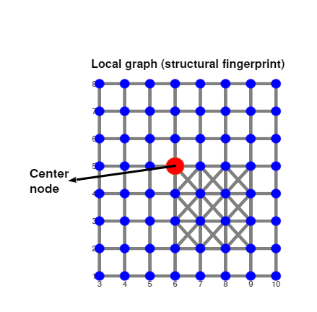
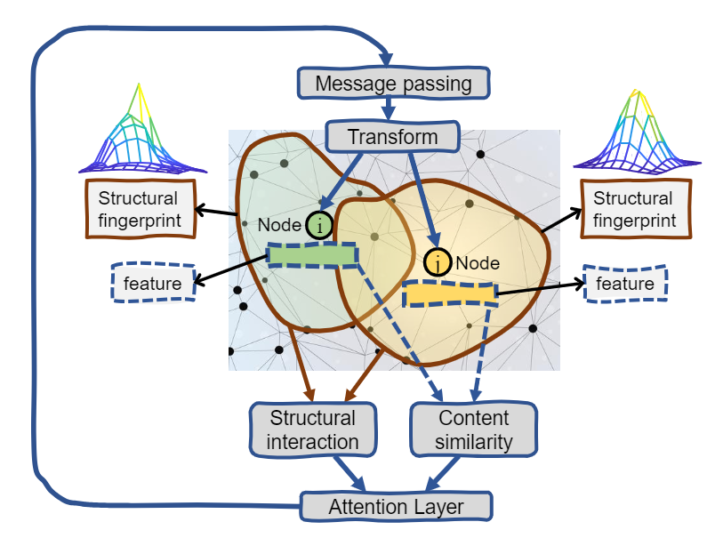
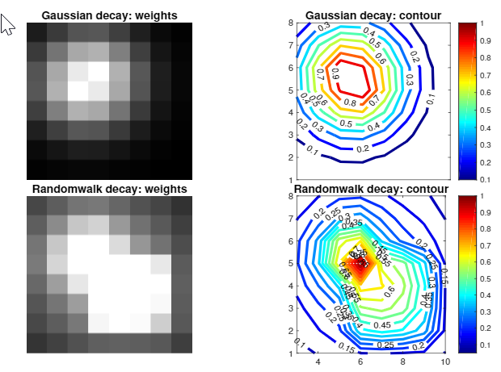
Research Highlights
Graph Attention Networks [ICLR 2020]
Incorporating structural clues to improve content-based graph attention

Slide 8
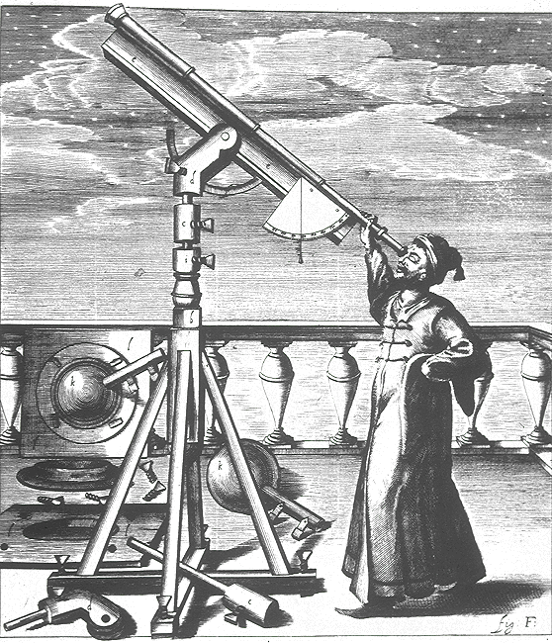
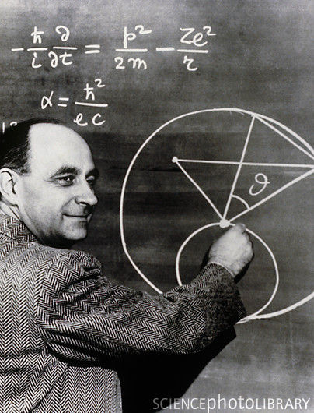
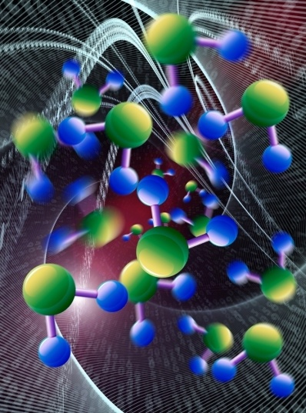
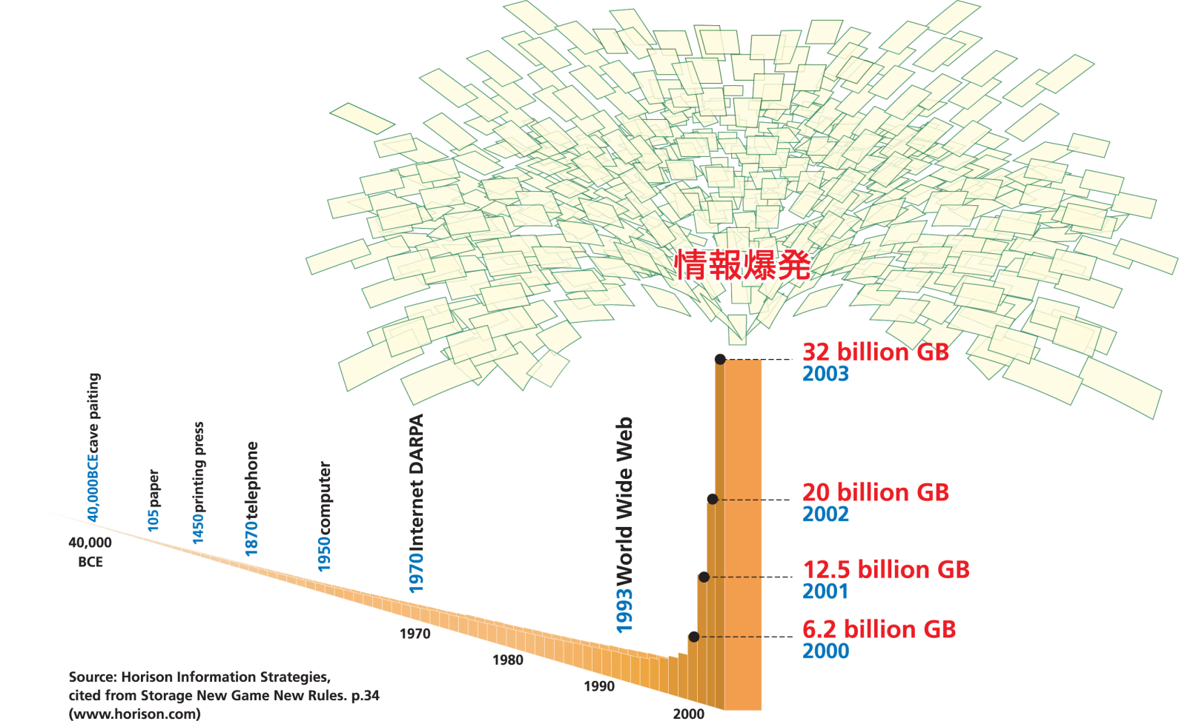


Data Intensive Research
empirical
theoretical
simulation
data intensive

Slide 9
History of Deep Learning Milestones
1943: Neural networks
1957-62: Perceptron
1970-86: Backpropagation, RBM, RNN
1979-98: CNN, MNIST, LSTM, Bidirectional RNN
2006: “Deep Learning”, Deep Belief Network
2009: ImageNet + AlexNet
2014: GANs
2016-17: AlphaGo, AlphaZero
2017-19: Transformers, BERT
2020-now：self-supervised learning, contrastive learning, Transformer application outside NLP domains

Slide 10
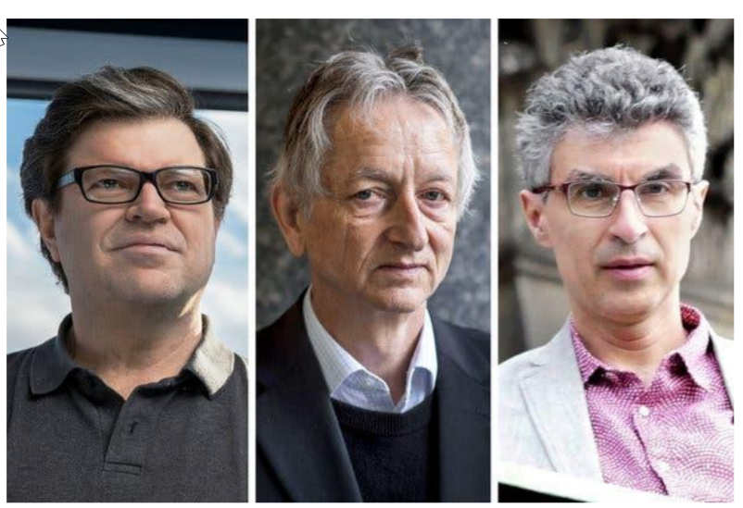
Turing Award for Deep Learning
• Yann LeCun
• Geoffrey Hinton
• Yoshua Bengio
Turing Award given for:
“The conceptual and engineering breakthroughs that have made deep neural networks a critical component of computing.”

Slide 11
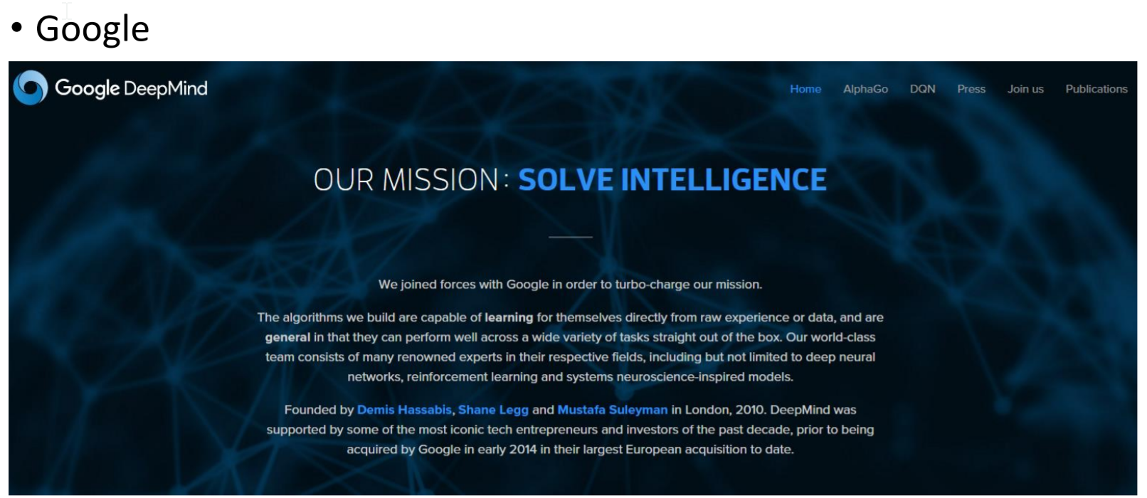
Deep Learning in Industry

Slide 12

Deep Learning in Industry
Facebook AI Research

Slide 13
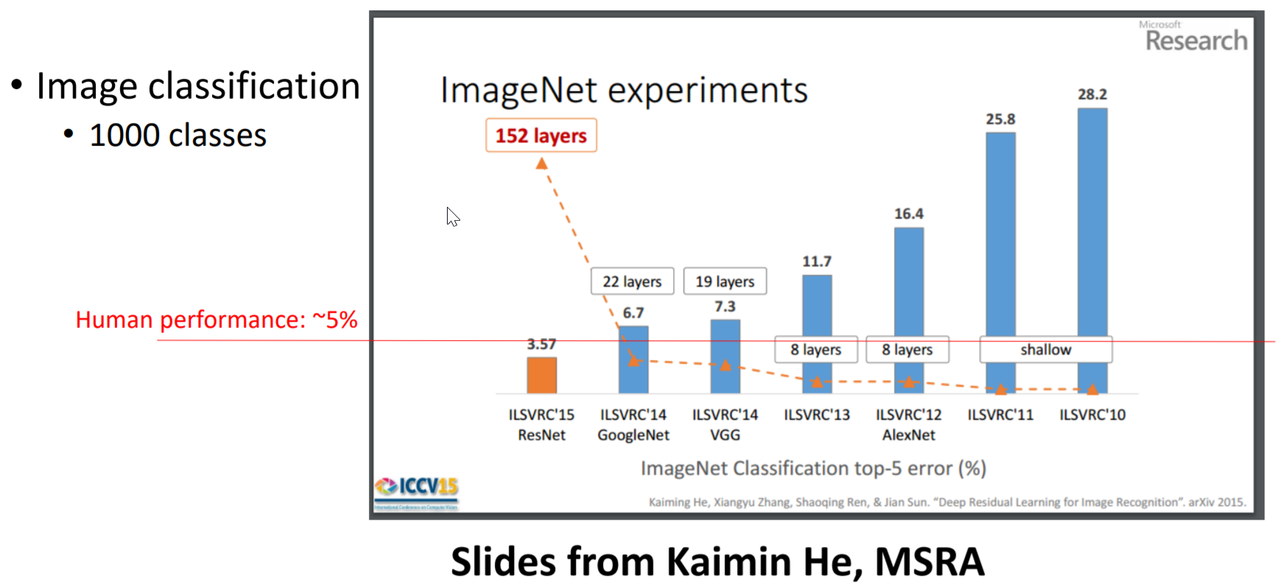
Deep Learning Applications

Slide 14
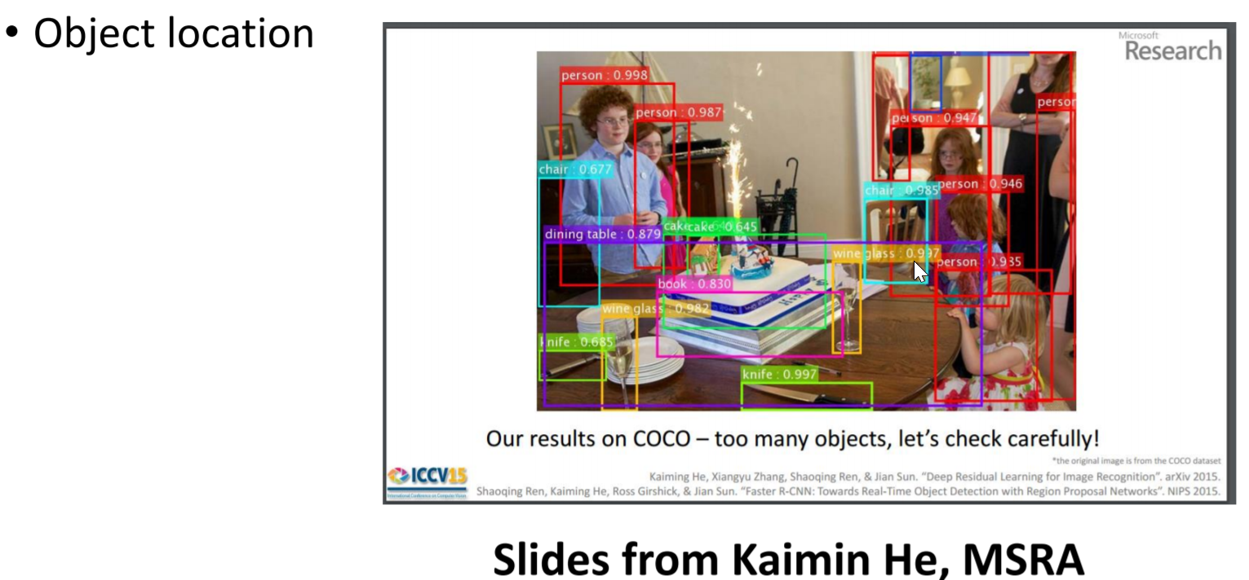
Deep Learning Applications

Slide 15
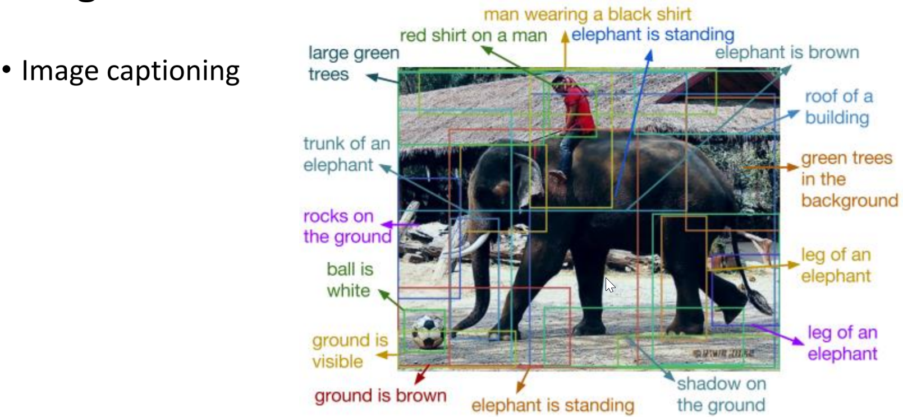
Deep Learning Applications
Figure from the paper “DenseCap: Fully Convolutional Localization Networks for Dense Captioning”, by Justin Johnson, Andrej Karpathy, Li Fei-Fei

Slide 16
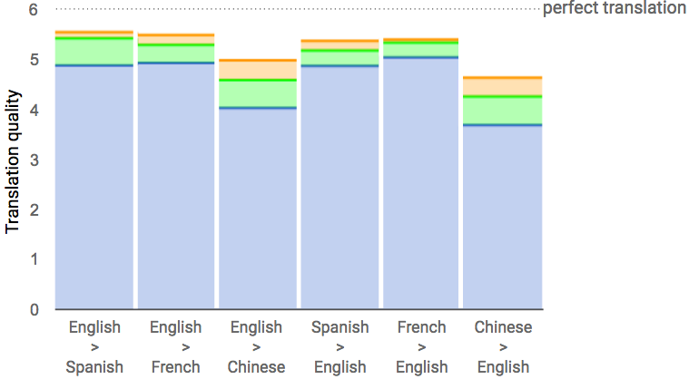
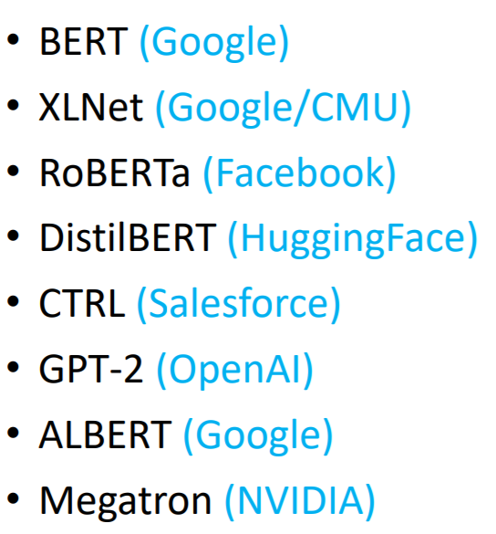
Deep Learning Applications
Language Models
human
DNN
Traditional NLP
Translation

Slide 17
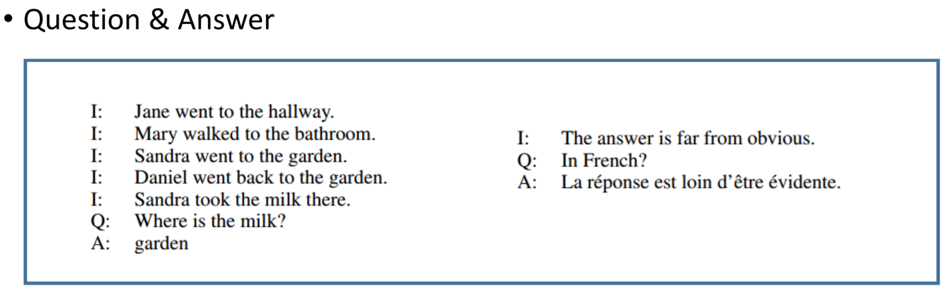
Deep Learning Applications
Figures from the paper “Ask Me Anything: Dynamic Memory Networks for Natural Language Processing ”, by Ankit Kumar, Ozan Irsoy, Peter Ondruska, Mohit Iyyer, James Bradbury, Ishaan Gulrajani, Richard Socher

Slide 18
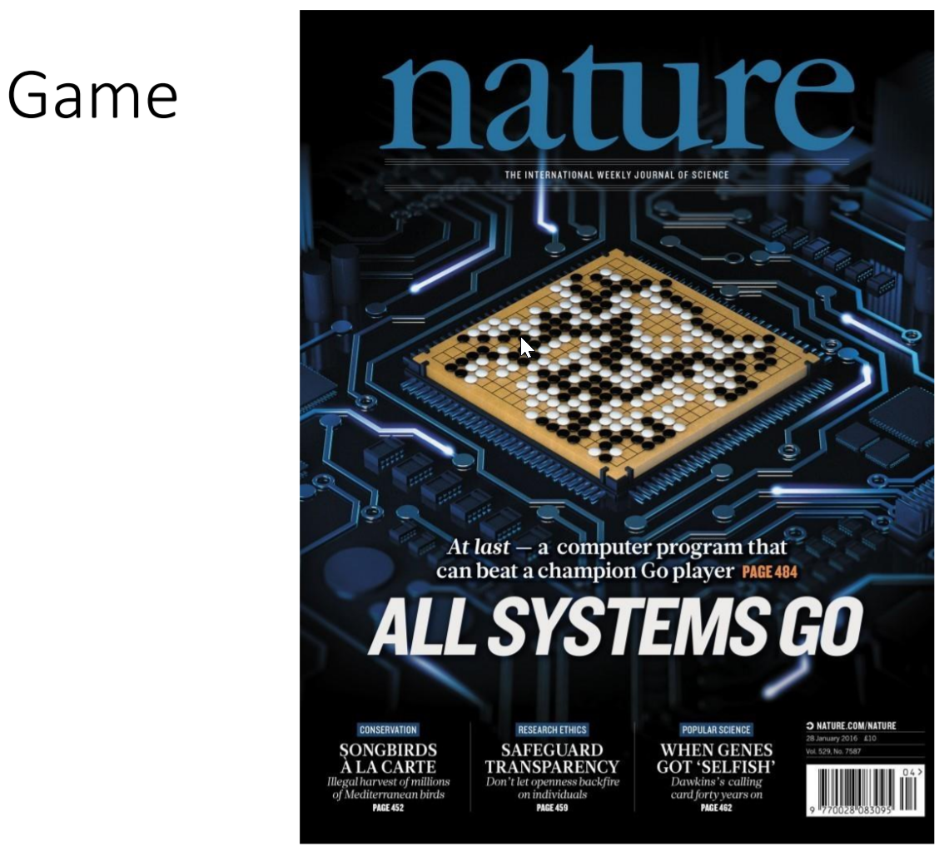
Deep Learning Applications

Slide 19

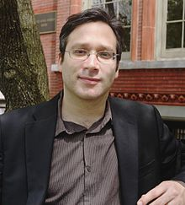

Different Voices of Deep Learning
Ali Rahimi, NIPS Test of Time Award
“current practice in machine learning is akin to "alchemy"
Gary Marcus, neural scientist (natural and artificial intelligence)
Gary has been a critical voice highlighting the limits of deep learning and discussing the challenges before the AI community that must be solved in order to achieve artificial general intelligence.
https://lexfridman.com/ai

Slide 20
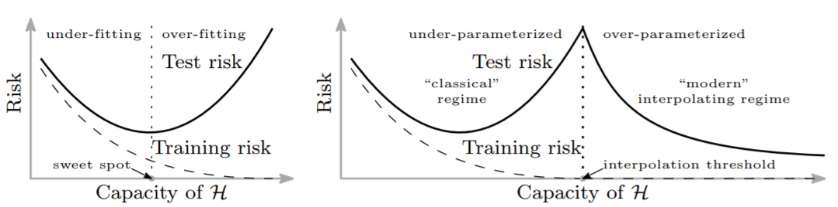
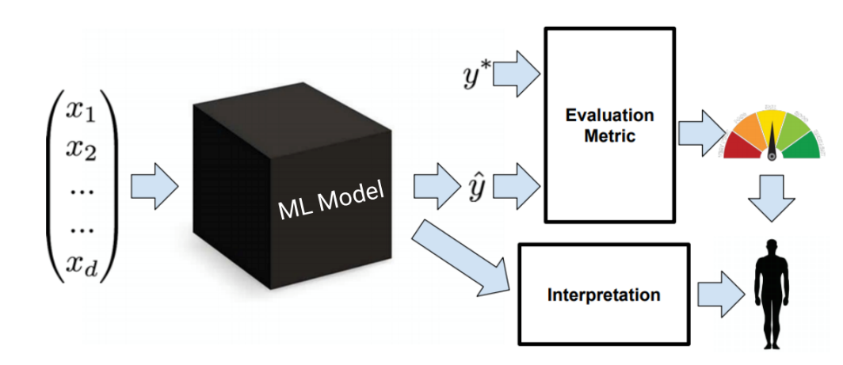

Deep Learning Challenges
Theories
Interpretability
Efficiency
Causality, Reasoning, General Intelligence…

Slide 21
Topics in CIS 5525
Introduction (Basics)
Linear algebra, matrix (low-rank) decomposition, kernel methods, graphs and manifold learning
A bit of History of Neural Networks
Cognition, Neural Science, Connectism
Perceptron, MLP
Autoencoders
Denoising autoencoders, deep clustering
Optimization and Normalization Techniques in Deep Learning
Convolutional Neural Networks
Recurrent Neural Networks
RNN, LSTM, Sequence Modelling
Attention and Memory
Attention mechanism, memory networks, BERT language models
Graph Neural/Convolutional Networks
Deep Generative Networks
GAN, Variational Autoencoders
Deep Reinforcement Learning
Neural Architecture Search

Slide 22
Some Basics in Machine Learning
Linear Algebra
Kernel Methods
Manifold learning
Graph Signal Processing

Slide 23
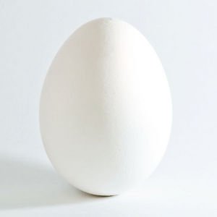
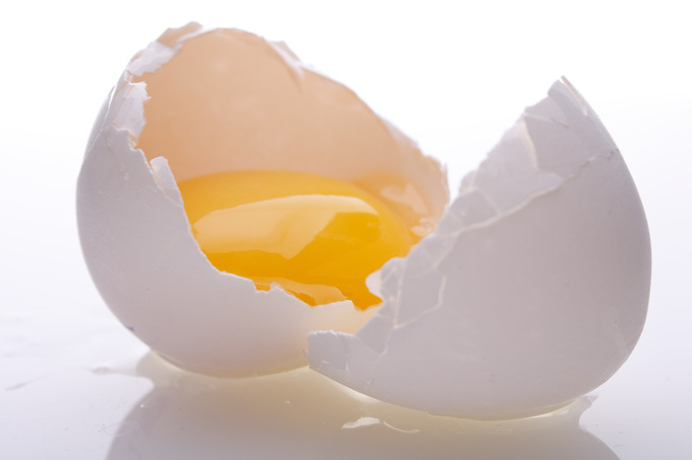
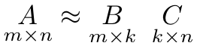
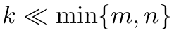
Low-rank Decomposition
Definition: transformation of a given matrix into product of matrices, or pre-defined canonical forms

Slide 24
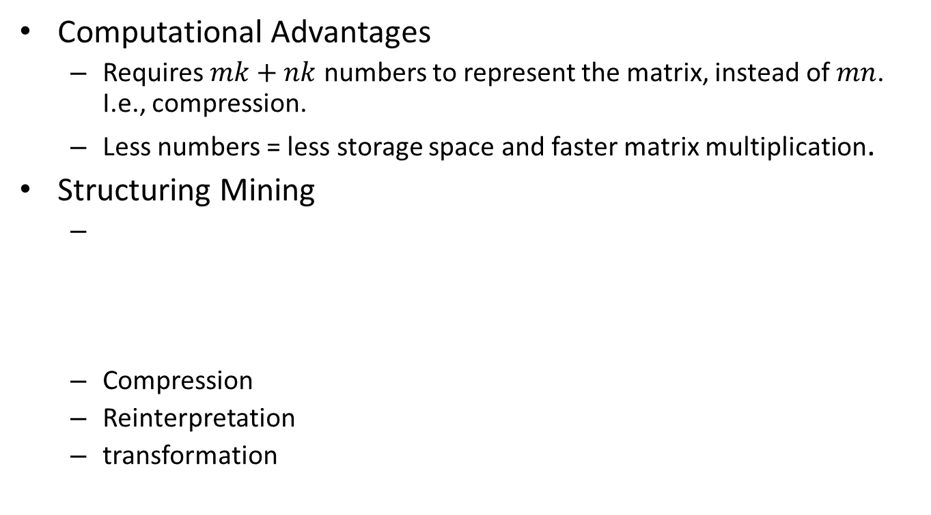
Usefulness of Low-rank Decomposition
Computational Advantages
Requires $mk+nk$ numbers to represent the matrix, instead of $mn$. I.e., compression.
Less numbers = less storage space and faster matrix multiplication.
Structuring Mining
Compression
Reinterpretation
transformation
The basis contains important structural information of the data

Slide 25
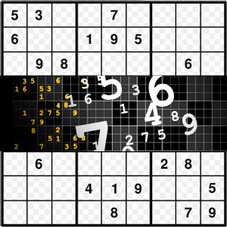
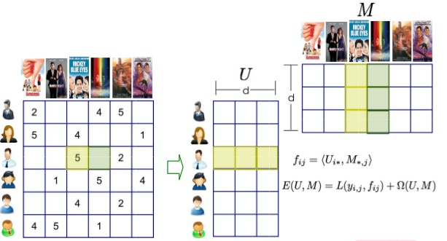
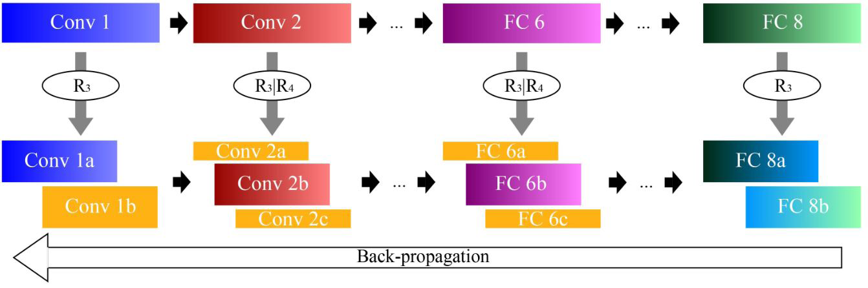
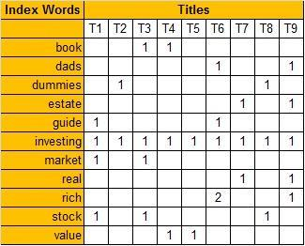
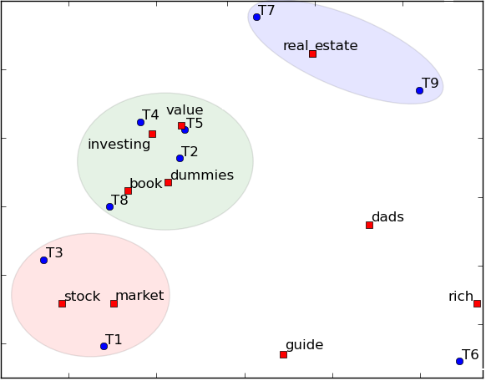
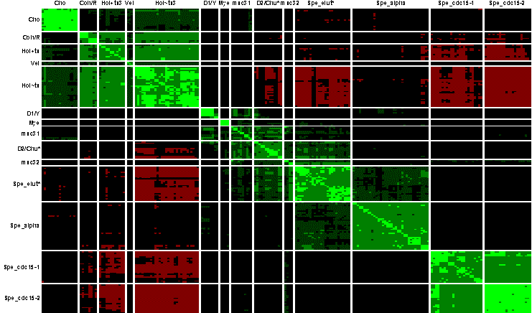










Matrix Approx. Comes Into Play!
Low-rank Approximation
$$A$$
$$=$$
$$P$$
$×$
Reduce problem size, complexity
Structure mining
$$Q^{T}$$
Fundamental building block in modern computing
Universal Applicability
Information Technology (information retrieval, recommender systems)
Computer Vision (image processing, face recognition, video surveillance)
Computer Graphics (3D reconstruction, relighting, rendering)
Bioinformatics (clustering, network analysis, gene expression analysis)
Deep Networks (model compression, energy saving)
Optimization (linear systems, newton method)
Data gathered from 1998
12th Release: 4 million spectra
Notes:
Towards this end, matrix approixmation is a promisiing method towards large scale machine learning. Matrix approximation Aims at decomposeing the large matrix into products of low-rank factors. Therefore it can greatly reduce the problem size and complexity. On the other hand, due to the product form, makes it very useful for structure mining patterns from data. More importantly, mr is a founamernal tool underlying ml dm, as well as other domains. Here I will show you some examples.

Slide 26




Vector norms
$$\left[\begin{matrix}x_{1} \\ x_{2} \\ \begin{matrix}… \\ x_{n}\end{matrix}\end{matrix}\right]$$
Vector norms measure the magnitude of a vector $x=$
$L_{1}$ norm:
$L_{2}$ norm
$L_{∞}$ (infinite) norm
Norm Properties, given give $u=[u_{1}u_{2} …u_{n}]′$, $v=[v_{1}v_{2} …v_{n}]′$
Triangular inequality (Minkowski’s inequality) ${\left\|u+v\right\|}_{p}≤{\left\|u\right\|}_{p}+{\left\|v\right\|}_{p}$
Cauchy–Schwarz inequality: $\left|\left\langle u,v\right\rangle \right|≤{\left\|u\right\|}_{2}{\left\|v\right\|}_{2}$
inner product $\left\langle u,v\right\rangle =u^{′}v=\sum{u_{i}v_{i}}={\left\|u\right\|}_{2}{\left\|u\right\|}_{2}cos⁡(u|v)$

Slide 27




Matrix Norms
Induced matrix-$p$ norm
Frobenius-norm Hilbert-Schmidt norm
Properties
Triangular inequality${\left\|A+B\right\|}_{p}≤{\left\|A\right\|}_{p}+{\left\|B\right\|}_{p}$
Multiplicative inequality ${\left\|AB\right\|}_{p}≤{\left\|A\right\|}_{p}{\left\|B\right\|}_{p}$
Unitarily invariant ${\left\|UA\right\|}_{F}={\left\|UA\right\|}_{F}$ if $U$ is a unitary matrix ($UU$’ = $U$’ $U=I$)

Slide 28







Singular Value Decomposition
There are five mathematicians who were responsible for establishing the existence of the
singular value decomposition and developing its theory.
Eugenio Beltrami
(1835-1899)
Camille Jordan
(1838-1921)
James Joseph Sylvester
(1814-1897)
Erhard Schmidt
(1876-1959)
Hermann Weyl
(1885-1955)
The Singular Value Decomposition was originally developed by two mathematician in the
mid to late 1800’s, 1. Eugenio Beltrami , 2.Camille Jordan
Several other mathematicians took part in the final developments of the SVD including James
Joseph Sylvester, Erhard Schmidt and Hermann Weyl who studied the SVD into the mid-1900’s.
C. Eckart and G. Young prove low rank approximation of SVD.
C. Eckart
(1902-1973)
G. Young
(1915-1999)

Slide 29




Singular Value Decomposition (cont.)
Definition: Any real rectangular matrix A can be factored into
Tall & skinny:
(m > n)
Short & fat:
(m < n)

Slide 30






SVD Properties
$U=[u_{1}u_{2}…u_{m}]$ and $V=[v_{1}v_{2}…v_{n}]$ are left and right singular vectors, i.e., unitary matrices satisfying
$Σ$ is the non-negative, diagonal singular-value matrix
Here k is the number of non-zero singular values (i.e., rank of A)

Slide 31


Truncated SVD
Computational Complexity
A full SVD costs $\min{(m^{2}n,mn^{2})}$ time
Computing top-k singular vectors takes $O(mnk)$ time, $k≪\min\left(m,n\right)$
Also called thin SVD

Slide 32




Low-rank Approximation
Theorem (Eckart-Young, 1936).
Let
. Then
is minimized by
with optimal value
32

Slide 33













SVD Re-interpretation
Each column is expressed as a linear combination of left singular vectors
Each column is compressed from $R^{m}$ vector to $R^{r}$ (r is the rank)
Pairwise column-distance is preserved in re-scaled right singular vectors
$$A$$
$$U$$
$$Σ$$
$$V’$$
$$U$$
=
$$A_{[:,i]}$$
$$A_{[:,j]}$$
$A_{[:,i]}=UΣV_{[i,:]}^{′}$=$\sum_{l=1}^{r}{U_{[:,i]}∗\left(Σ_{[i,i]}∗V_{[i,l]}^{}\right)}$
$${\left\|A_{[:,i]}−A_{[:,j]}\right\|}_{2}={\left\|Σ(V_{\left[i,:\right]}^{}−V_{[j,:]}^{})′ \right\|}_{2}$$
$$ΣV_{\left[i,:\right]}^{}$$
$$ΣV_{\left[i,:\right]}^{}$$
$k−$dimensional space

Slide 34





Latent Sematic Indexing
Latent semantic analysis (LSA) is a NLP technique for analyzing relation between a set of documents and the terms they contain through SVD.
$$q$$
q1: human machine interface for Lab ABC computer applications
q2: a survey of user opinion of computer system response time.
q3: the EPS user interface management system
q4: System and human system engineering testing of EPS
q5:Relation of user-perceived response time to error measurement
q6: The generation of random, binary, unordered tree
q7: The intersection graph of paths in trees
q8: Graph minors IV: Widths of trees and well-quasi-ordering
q9: Graph minors: A survey
$$V_{q}$$
$$A=UΣV^{′}, V={A^{′}UΣ}^{−1}$$
$$V_{q}={{q }^{′}UΣ}^{−1}$$

Slide 35

Pseudo Inverse
Non-square m-by-n matrix $A$ typically has no inverse
Moore-Penrose generalized inverse is an n-by-m matrix $A^{+}$such that
$AA^{+}A=A,A^{+}AA^{+}=A^{+},{\left(AA^{+}\right)}^{′}=AA^{+},{\left(A^{+}A\right)}^{′}=A^{+}A$
Can be defined as the solution of the following linear system
$Ax=b, x={(A^{′}A)}^{−1}A^{′}b, i.e., x=A^{+}b$
Can be computed by the SVD of $A$

Slide 36








Orthogonal projection
Vector $x$ projection onto unit vector $q$ ${(q}^{′}q=1, or {\left\|q\right\|}_{2}=1)$
Project matrix $A$ onto orthonormal basis $Q$:
What if Q’s columns are not orthogonal?
example: choose representative columns from $A$, as $Q= A_{[:,I]}$, and reconstruct $A$
$$Q$$
$$A≈QQ^{+}A$$
$$A≈{Q\left(Q^{′}Q\right)}^{−1}Q^{′}A$$
$$A$$

Slide 37
















Eigenvalue Decomposition
Eigenvalue decomposition of a square m×m matrix S is defined by
Equivalent to
Non-zero solution if
This is a m-th order equation of λ, with at most m distinct solutions (roots of the characteristic polynomial) – can be complex even though S is real.
In case of symmetric matrix, $S=V′ΣV$ with all real eigenvalues
Example
(right) eigenvector
eigenvalue
$S$=$V^{−1}ΣV$
$$S= \left[v_{1}v_{2}…v_{m}\right]\left[\begin{matrix}λ_{1} & & \\ & λ_{2} & \\ & & λ_{m}\end{matrix}\right]\left[\begin{matrix}v_{1}′ \\ v_{2}′ \\ v_{m}′\end{matrix}\right]$$

Slide 38






PSD Matrix and Cholesky Factorization
The symmetric matrix $A$ is said positive semi-definite ($A≽0$) if all its eigenvalues are non-negative
For any vector x one has $x^{′}Ax≥0$
There exists $A^{\frac{1}{2}}$ such that $A^{\frac{1}{2}}∙A^{\frac{1}{2}}=A$
Examples
Covariance matrix, kernel matrix, diffusion tensors
Cholesky Decomposition
Any PSD matrix can be written as $A={LL}^{′}$, with $L$ is lower-triangular matrix
Taking $n^{3}/3$ flop operations
can be interpreted as ‘square root’ of a positive definite matrix
$$x_{j}$$
$$x_{i}$$
$K_{ij}=k(x_{i},x_{j})$

Slide 39



LU Decomposition
LU decomposition was originally derived by Lagrange, in the very first paper in his collected works(1759) derives the algorithm we call Gaussian elimination. Later Turing introduced the LU decomposition of a matrix in 1948 that is used to solve the system of linear equation.
Defined as $A =L U$
Used to solve linear system of equations
Similar to Gaussian Elimination
J-L Lagrange
(1736 –1813)
A. M. Turing
(1912-1954)

Slide 40






QR decomposition
An m-by-n matrix$A$can be factorized into $A=QR$
Applications: computing least squares
$Ax=b→QRx=b→Rx=Q^{′}b$ (can be solved easily with triangular $R$)
Extracting orthogonal column basis from $A$, $range\left(A\right)=range(Q)$
Projection on range $AA^{+}=QQ′$
$$A∈R^{m×n}$$
$$Q∈R^{m×m}$$
$$R$$
=
$$R$$
Upper
triangular
Orthonormal columns

Slide 41





Kernel Methods
Kernel $K:{ℝ }^{d}×{ℝ }^{d}→$ $ℝ$ is a similarity measure that can be written as
Example: Polynomial kernel
T
(implicit) feature map
Kernel function

Slide 42

Kernel-based Learning
x₁
Linear algorithm
Embed data
Data
K
x_{n}
SVM, MPM, PCA, CCA, FDA…
H: Hilbert or feature space
Kernel design
Kernel algorithm

Slide 43


Kernel Function

Slide 44


Eigenvalue Decomposition of the Kernel Matrix
Examples: Kernel Principal Component Analysis
https://people.eecs.berkeley.edu/~wainwrig/stat241b/scholkopf_kernel.pdf
Basic step:
Given a set of samples, compute the kernel matrix
Normalize the kernel matrix
Compute the eigenvalue decomposition
The eigenvectors serve as a useful embedding for sub-sequent learning tasks
MNIST digit data set

Slide 45


Manifold Learning
Manifold Learning (or non-linear dimensionality reduction) embeds data that originally lies in a high dimensional space in a lower dimensional space, while preserving characteristic properties.
a manifold is a topological space that locally resembles Euclidean space near each point.

Slide 46


Mapmaking problem
A
B
B
A
Earth (sphere)
Planar map

Slide 47

Image Examples
Objective: to find a small number of features that represent a large number of observed dimensions.
For each image: there are 64x64 = 4096 pixels (observed dimensions)
Assumption: High-dimensional data often lies on or near a much lower dimensional, curved manifold.

Slide 48

ISOMAP Embedding

Slide 49
Stochastic Neighborhood Embedding
A probabilistic version of local MDS
more important to get local distances right than non-local ones
has a probabilistic way of deciding if a pairwise distance is “local”.
High-D Space
probability of picking j given that you start at i
k
j
i

Slide 50
Stochastic Neighborhood Embedding
Give each data point a location in the low- dimensional space.
Evaluate this representation by seeing how well the low-D probabilities model the high-D ones.
High-D Space
probability of picking j given that you start at i
k
j
i

Slide 51
The Cost Function
For points where pij is large and qij is small we lose a lot.
Nearby points in high-D really want to be nearby in low-D
For points where qij is large and pij is small we lose a little because we waste some of the probability mass in the Qi distribution.
Widely separated points in high-D have a mild preference for being widely separated in low-D.

Slide 52
Gradient Updates
Points are pulled towards each other if the p’s are bigger than the q’s and repelled if the q’s are bigger than the p’s
j
i

Slide 53


T-SNE
By using a Gaussian to compute P_ij and a heavy-tailed student’s t to compute Q_ij
a heavy-tailed Student-t distribution (with one-degree of freedom, which is the same as a Cauchy distribution) is used to measure similarities between low-dimensional points in order to allow dissimilar objects to be modeled far apart in the map.

Slide 54

Visualization of 6,000 digits from the MNIST dataset produced by t-SNE.

Slide 55

The COIL20 dataset
Each object is rotated about a vertical axis to produce a closed one-dimensional manifold of images.

Slide 56

Visualization of COIL20 produced by t-SNE.

Slide 57
Open problems in SNE
How to choose the bandwidth?
How to reduce the computational cost?
Large-VIS algorithm
https://arxiv.org/abs/1602.00370

Slide 58
Time Series Embedding Example
BOLD (Blood-oxygen-level dependent )signal
Signal of a single brain region
Signal of altogether 90 brain regions

Slide 59
Impact of perplexity
Perplexity controls the range of the neighborhood used in computing the probability distribution

Slide 60

The Laplacian Matrix of a Graph

Slide 61


Slide 62

Graph Signal Processing

Slide 63


Slide 64

Eigenvalue Decomposition of Laplacian
Eigenvectors associated with smaller eigenvalues have values that vary less rapidly along the edges

Slide 65

Eigenvector of Graph Laplacian

Slide 66


Graph Signal Processing
Vector Analysis
Any vector can be reconstructed by a set of complete orthogonal basis
Fourier Analysis
Any function or signal can be reconstructed by a set of complete orthogonal functions
Sine and Cosine waves (orthogonal)

Slide 67

Graph Signal Processing

Slide 68

Graph Fourier Transform

Slide 69

Graph Fourier Transform

Slide 70

Classic Signal Filtering

Slide 71




Graph Signal Filtering

Slide 72

Laplacian Smoothing Example

Slide 73

Image Denoising

Slide 74

Computer graphics Applications
Rendering on meshed surfaces

